Slide 1
Realism 1850-1880
Realism emphasized “everyday people and objects and rejected
Classical themes and ROMANTICISM’S subjectivity in favor
of objectivity and accurate renderings of the subject matter.”
The new movement is influenced by the invention of the camera,
and starts in France after the Revs of 1848. In France, realism is
linked with a desire for democracy. Realism in art is mostly restricted
to painting.
Artist include
FRANCE: USA
Honore Daumier
Gustave Courbet Sargent (lived in Europe)
Marie R. Bonheur Winslow homer
And Eduard Manet.

Slide 2
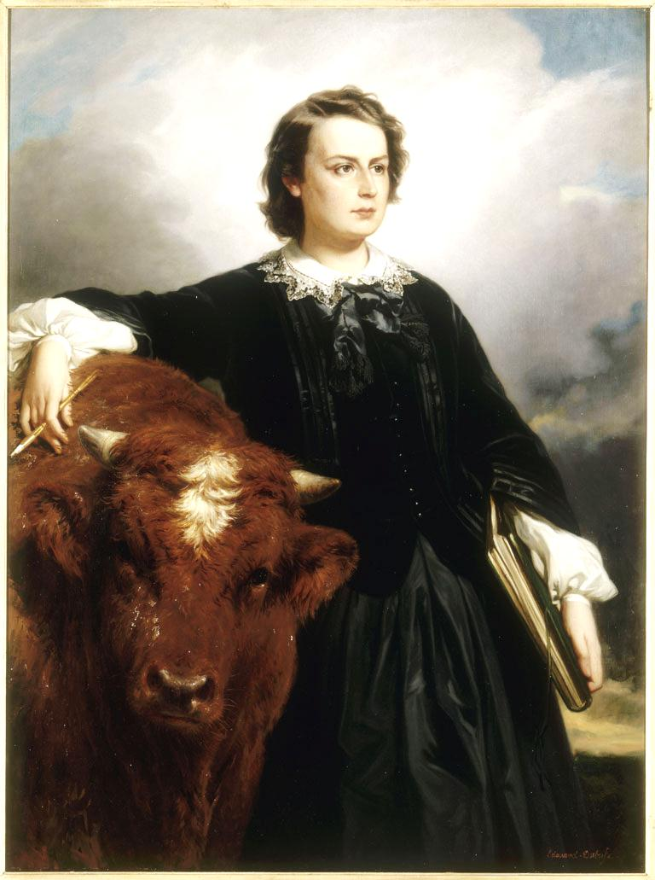
Marie Rosalie Bonheur
1822-1899

Slide 3
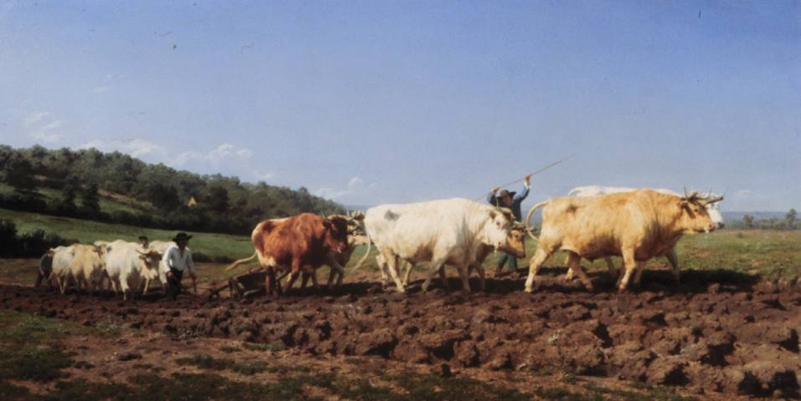
Marie Rosalie Bonheur, Plowing in the Nivernais, 1850, France

Slide 4
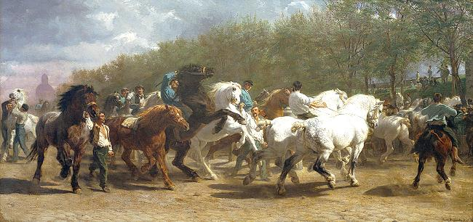
Marie Rosalie Bonheur, The Horse Fair, 1853-5, France

Slide 5
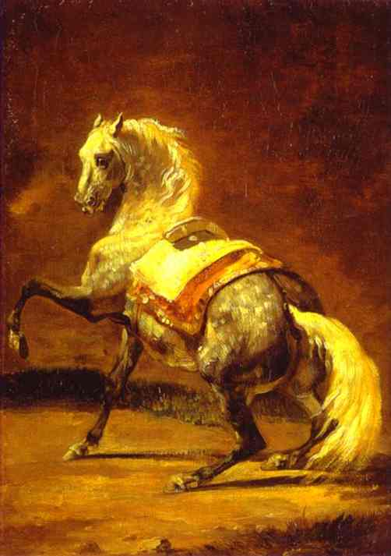
Gericault
Grey dappled Horse
Remember his
Raft of the Medusa

Slide 6
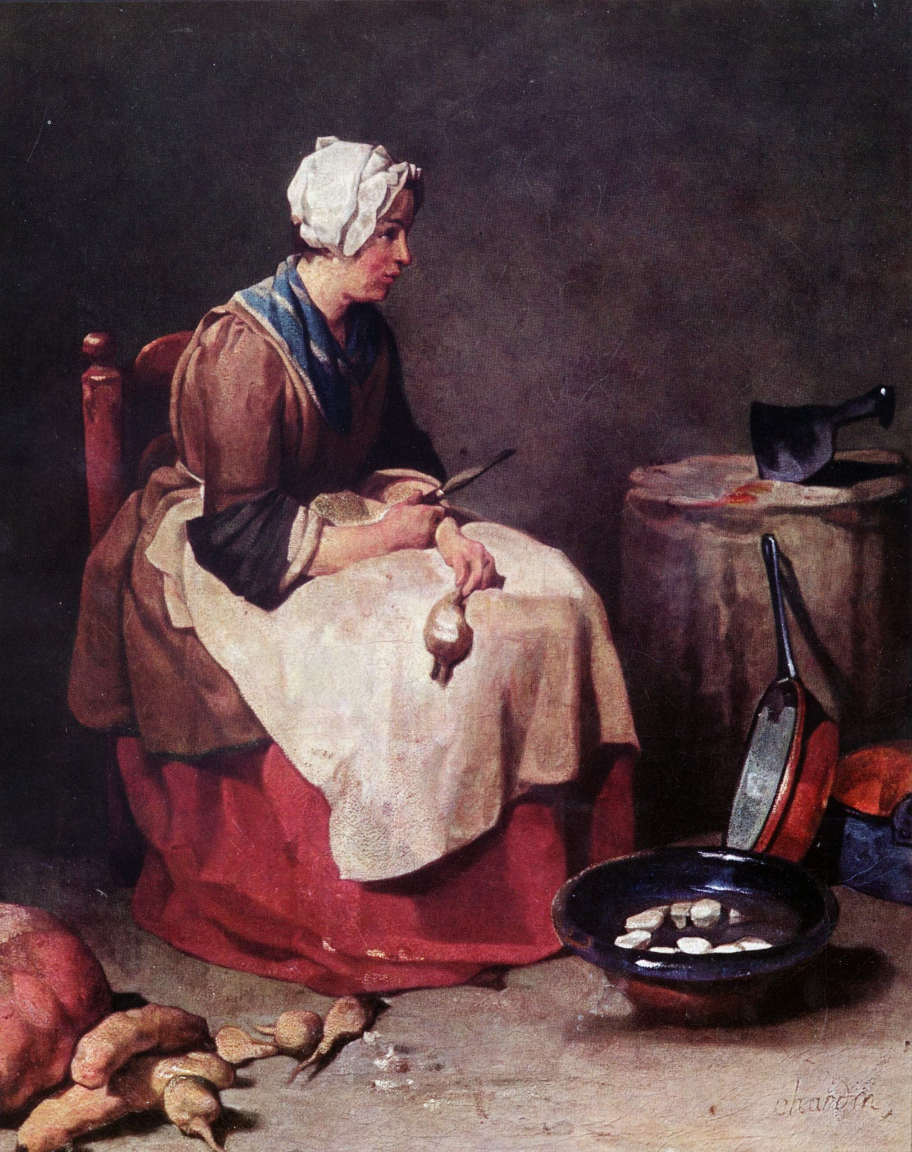
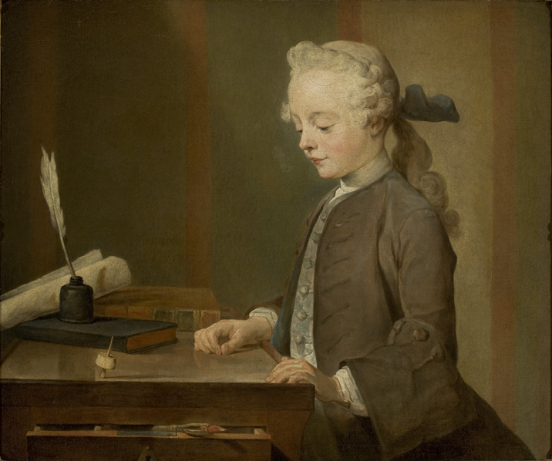
Jean-Baptiste-Siméon Chardin
1699 –1779)
Woman cleaning Turnips. 1738

Slide 7
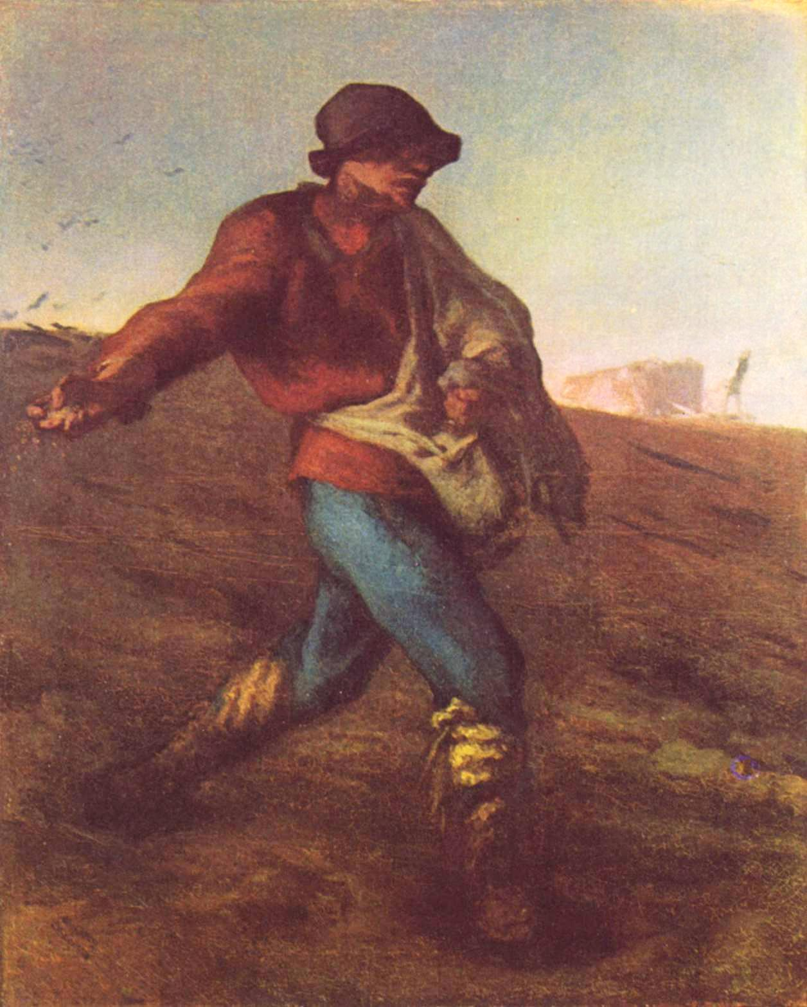
Jean-François Millet
1814 –1875
The Sower
Realism
Or the Barbizon School

Slide 8
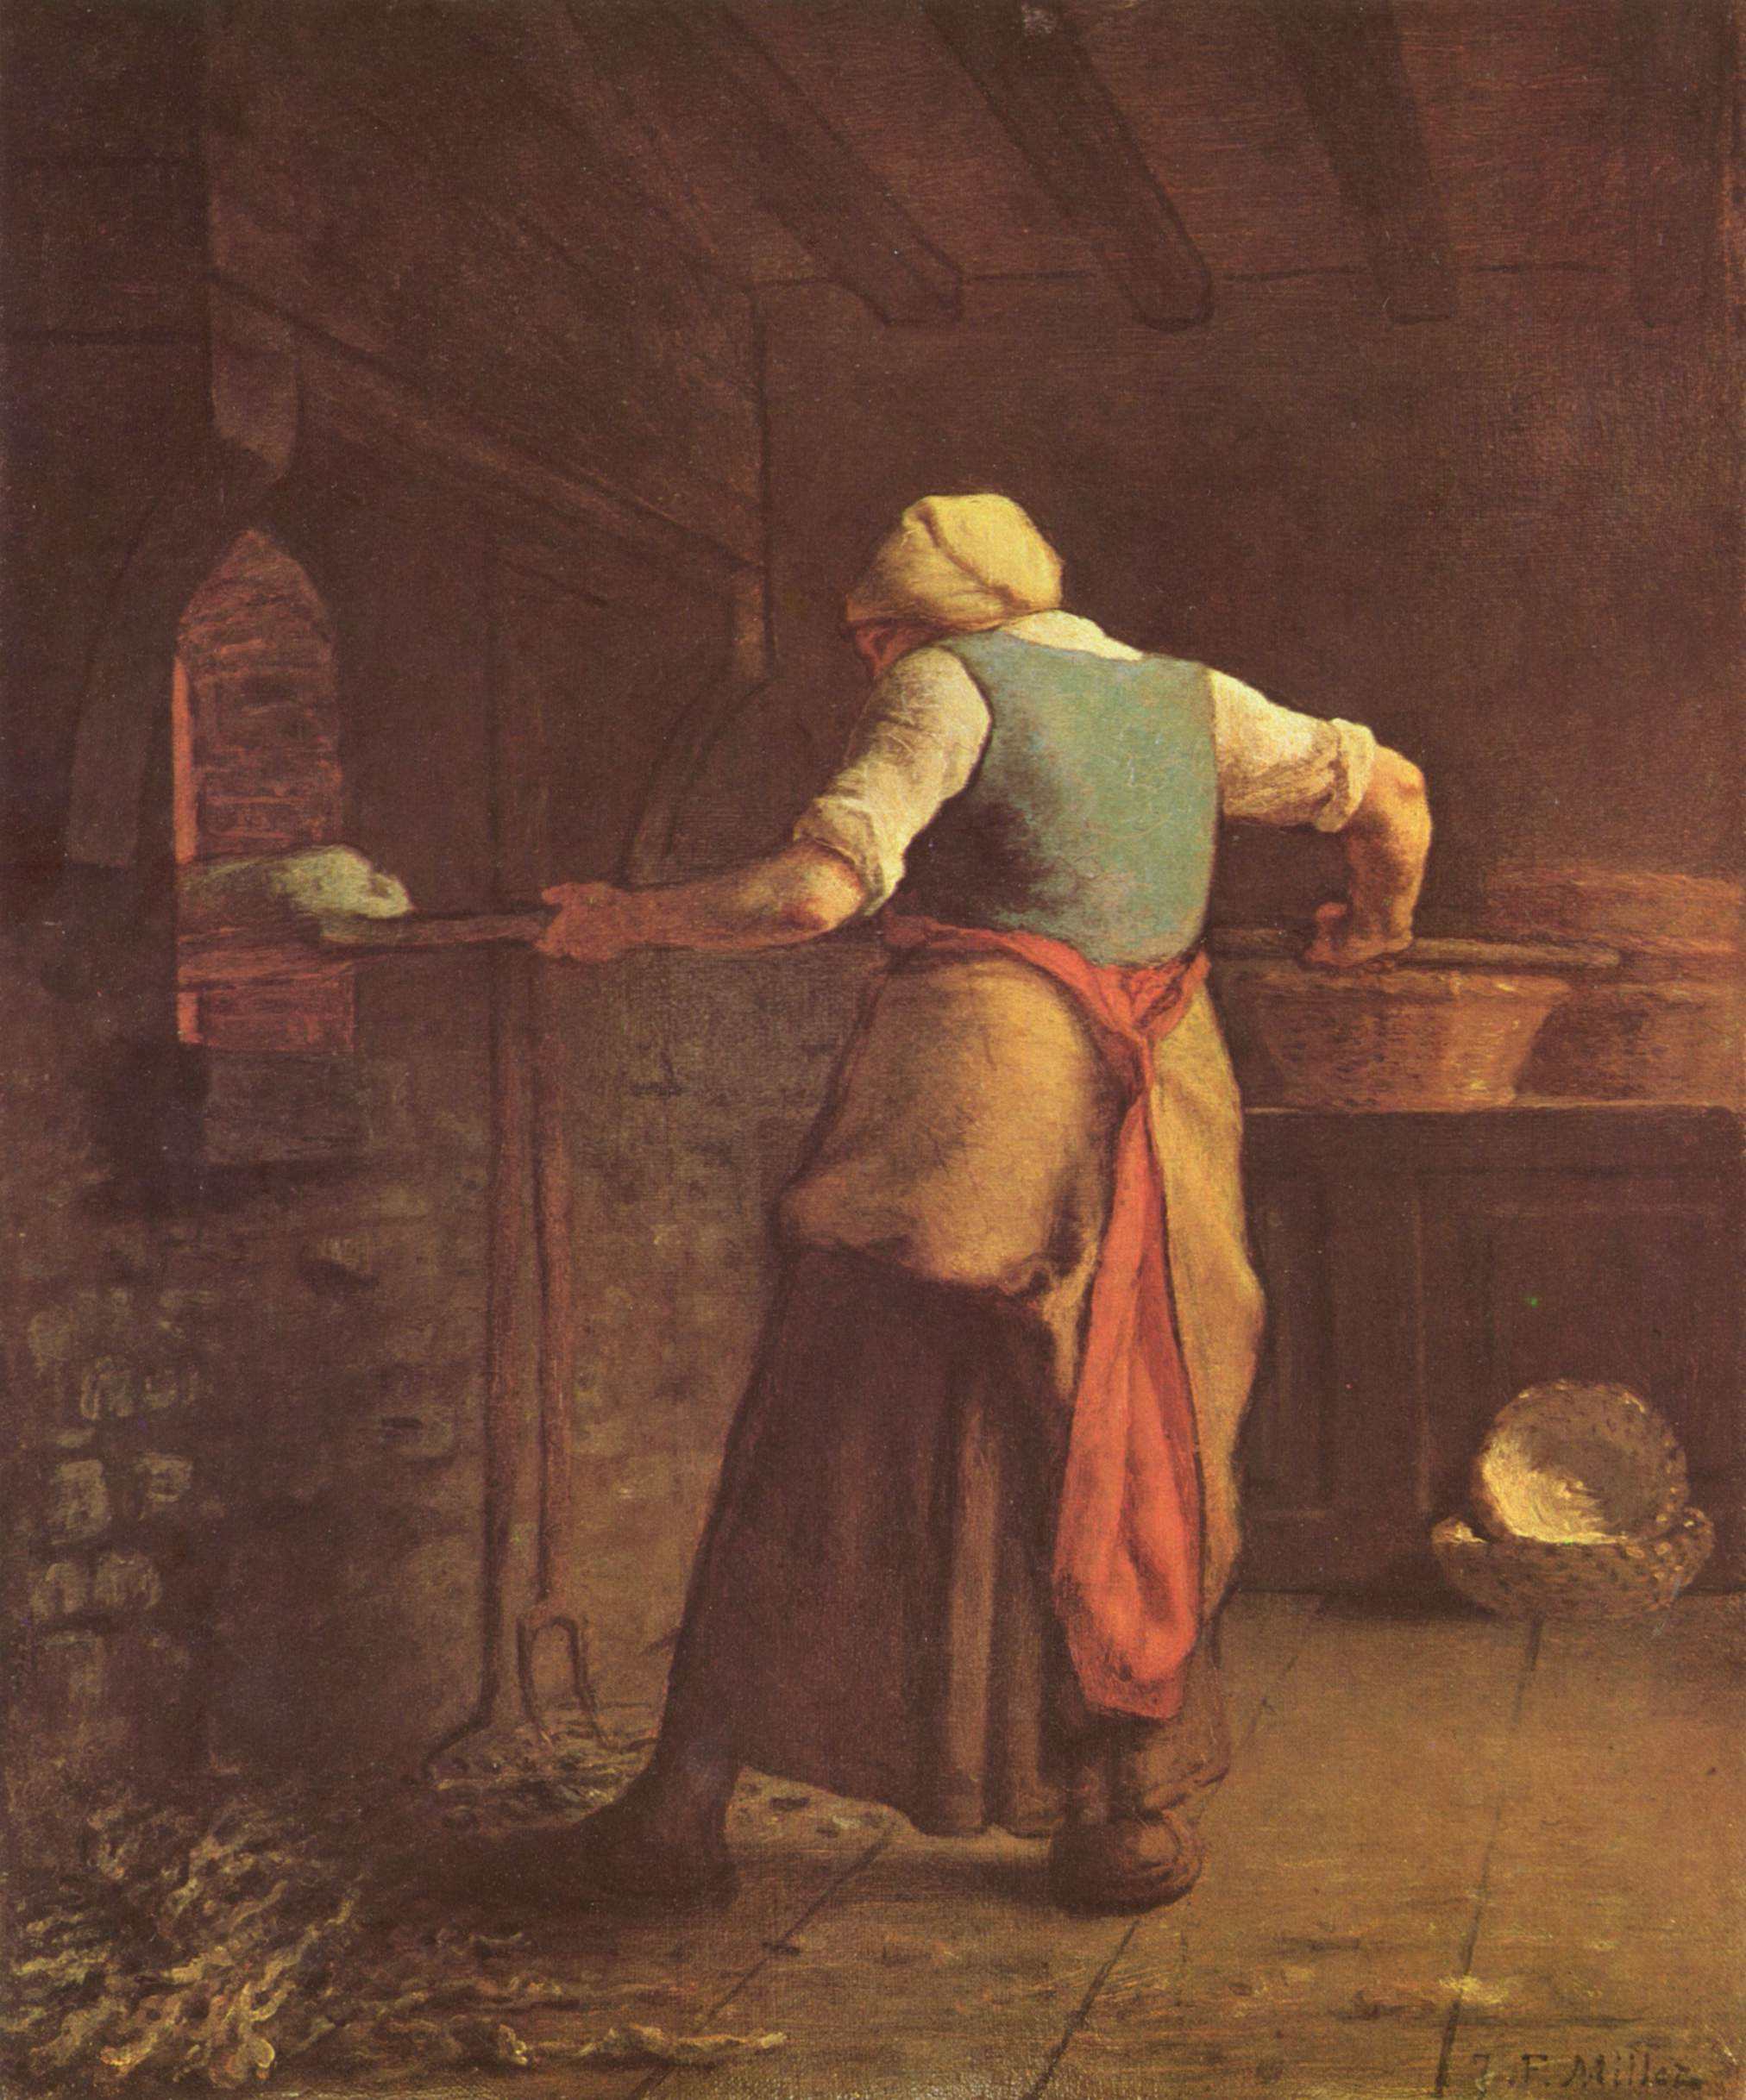
Millet
Woman baking Bread. 1854

Slide 9
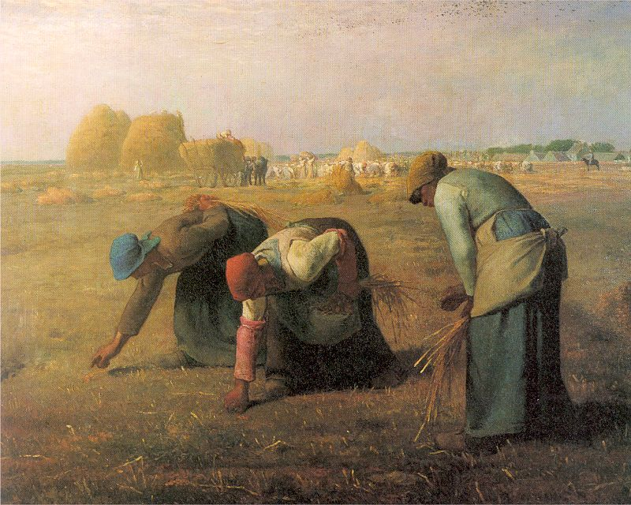

Slide 10
Millet, The Gleaners. 1875. (Note diffuse golden light and bent backs)

Slide 11
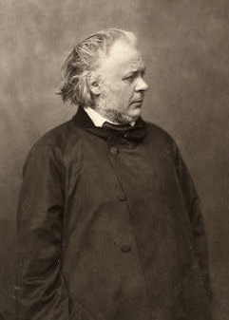
Honore Daumier
1808-79

Slide 12
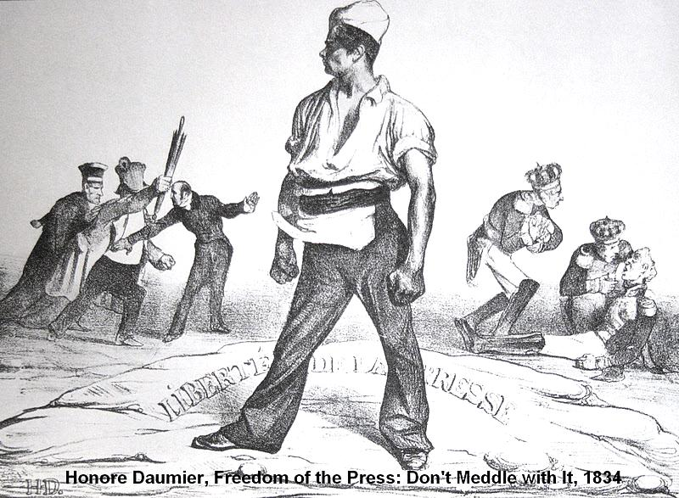
Title above, lithograph. Note the typesetter stands his ground while the last Bourbon
King, Charles X has fainted (right)

Slide 13
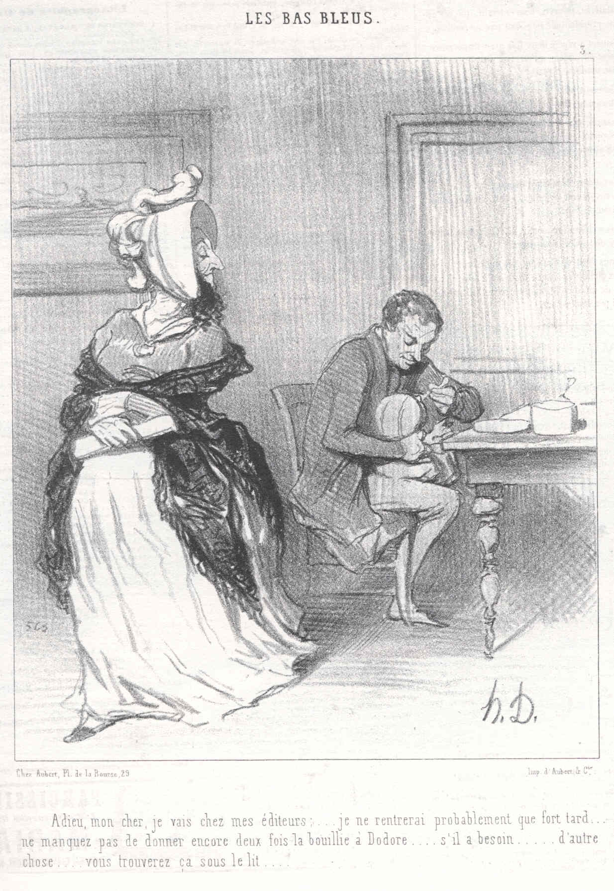
Daumier
Adieu, mon cher, je vais chez mes
editeurs…
Lithograph
1844
The ‘blue stockings” (bas bleu) were
French feminists.

Slide 14
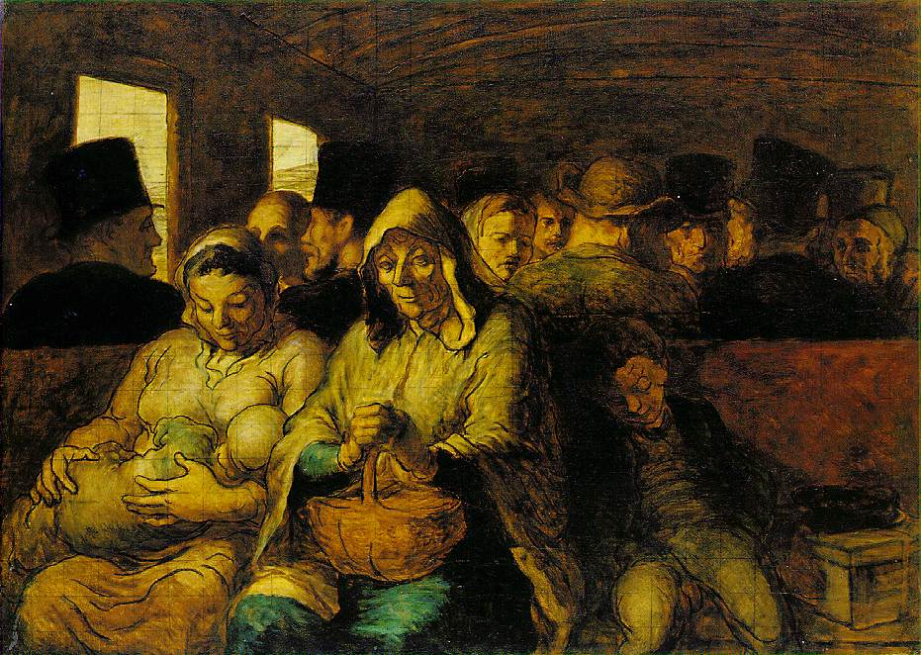

Slide 15
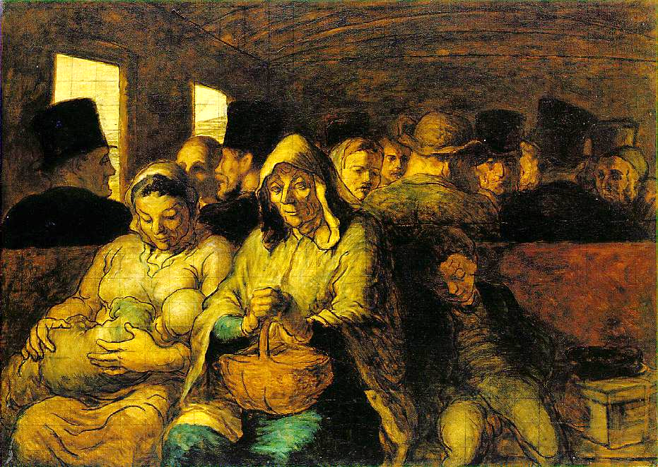

Slide 16
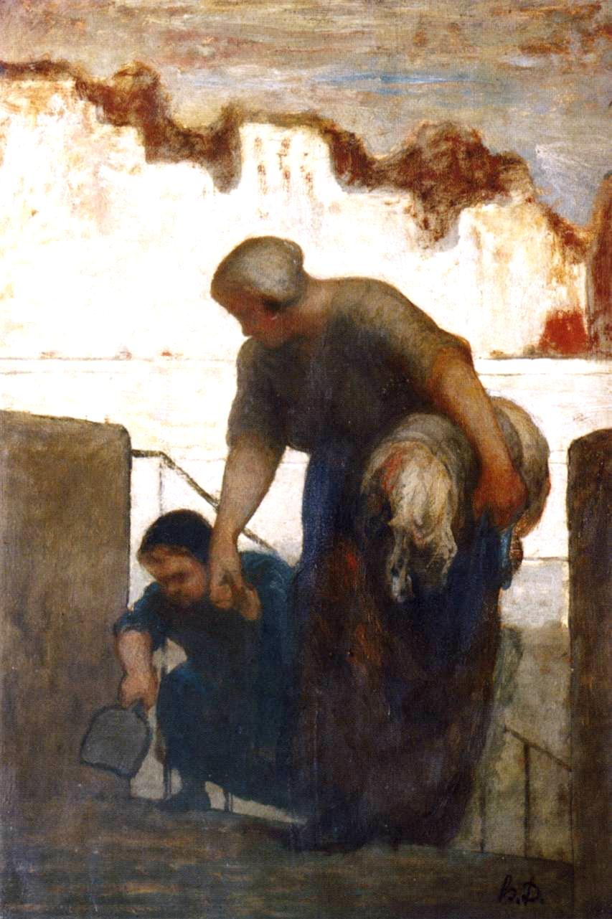
over
Honore Daumier
Third class Wagon
1865
MMA
The Washerwoman
1863

Slide 17
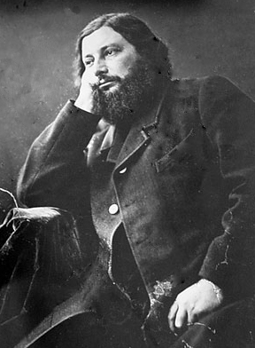
Gustave Courbet

Slide 18
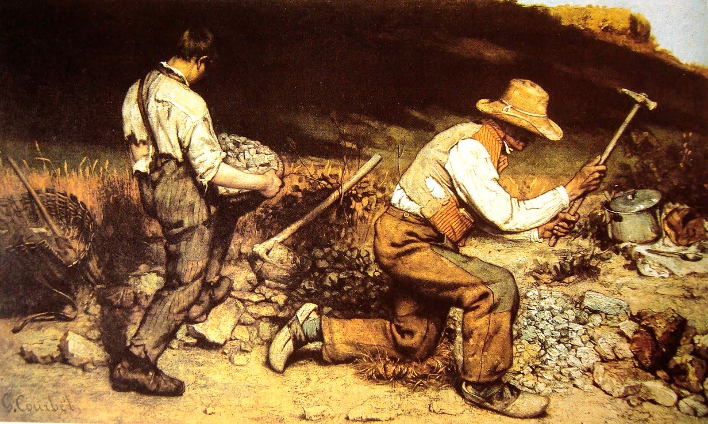
Gustave Courbet,1819 –1877, The Stone Breakers, 1849

Slide 19
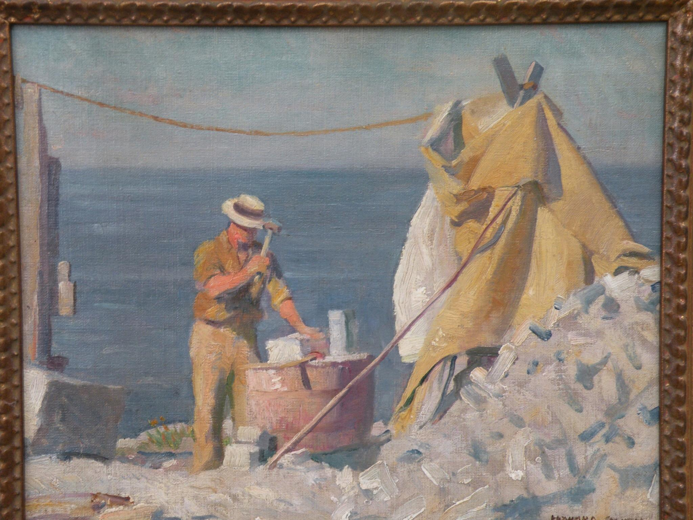

Slide 20
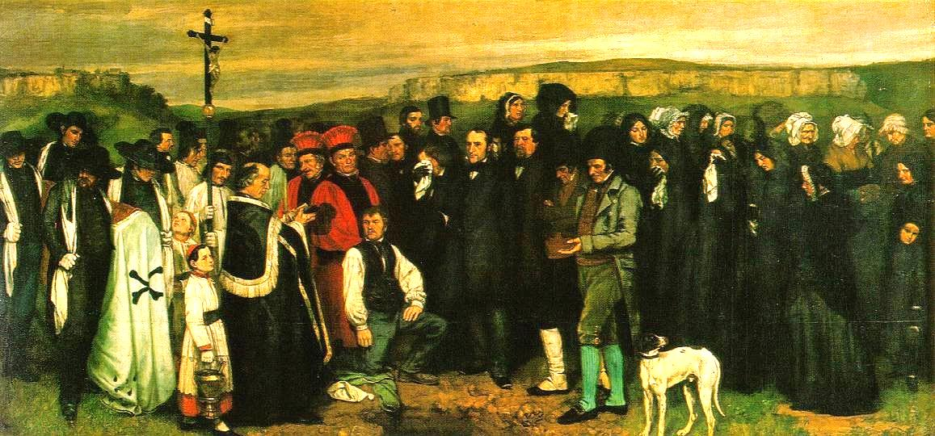
A Burial at Ornans, 1849-1850
He did not use models but painted each town person individually to get it correct

Slide 21
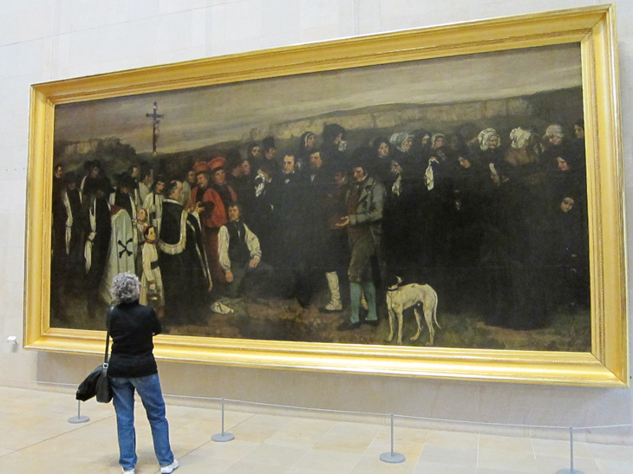

Slide 22
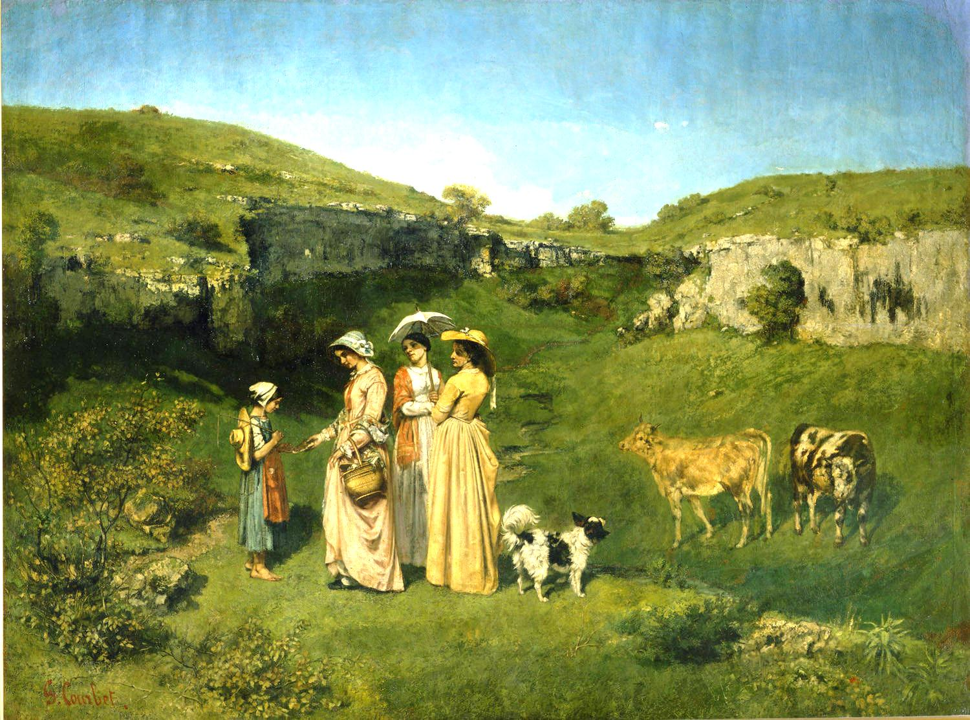

Slide 23
Courbet
Young Ladies from the Village
1851-52
Courbet had been criticized by the Salon in the past.
He thought this work of his sisters giving a gift to a cowherd would
Be liked by the Salon. Wrong. They criticized the women’s “common features,”
the ridiculous dog, and found the whole thing ugly.
So much for the Salon and REALISM!
MMA

Slide 24
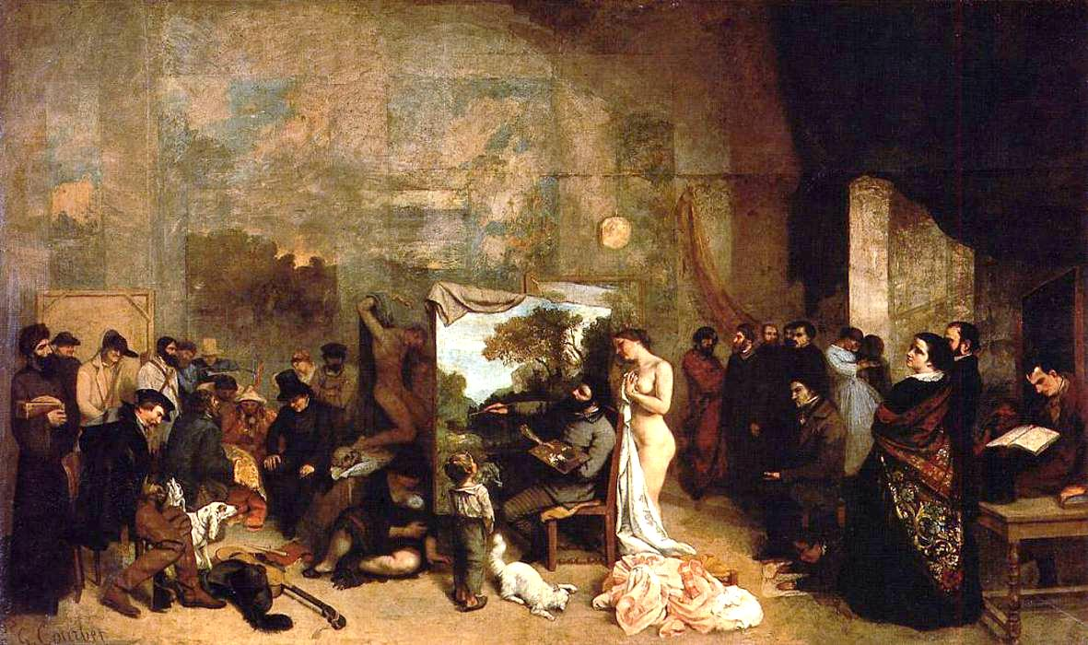

Slide 25
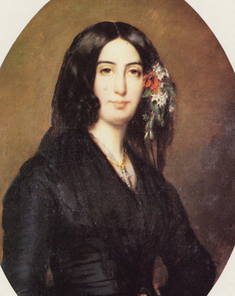
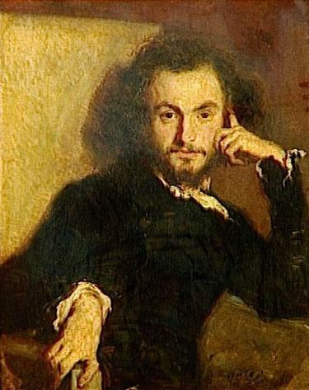
Courbet, The Artist’s Studio, an Allegory, 1854
Here Courbet is turning away from the nude who represents academic art,
to work on a landscape in his studio, with George Sands, Charles Baudelaire,
And other friends looking on.

Slide 26
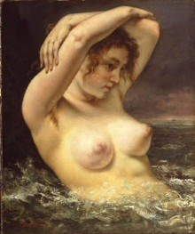
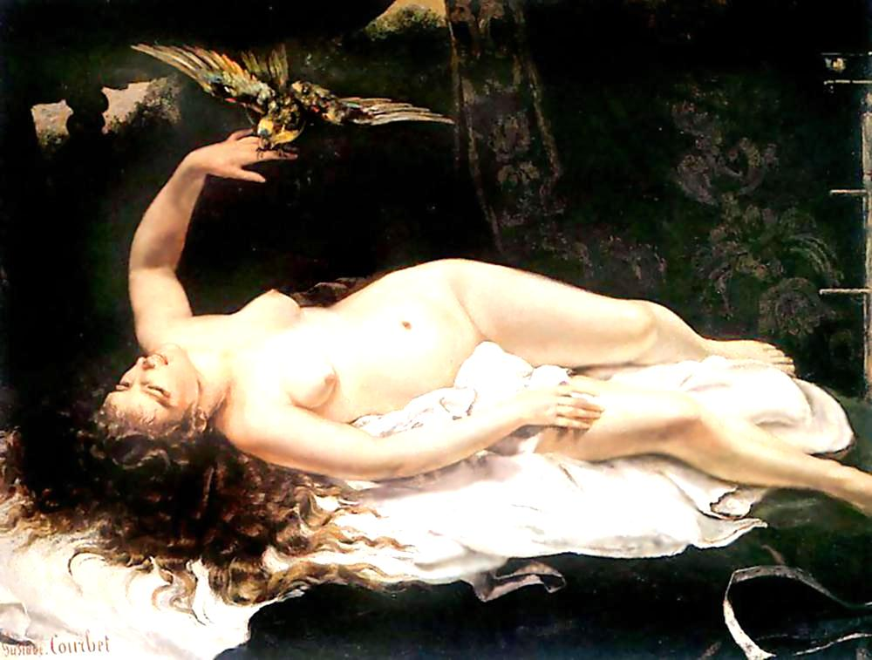

Slide 27
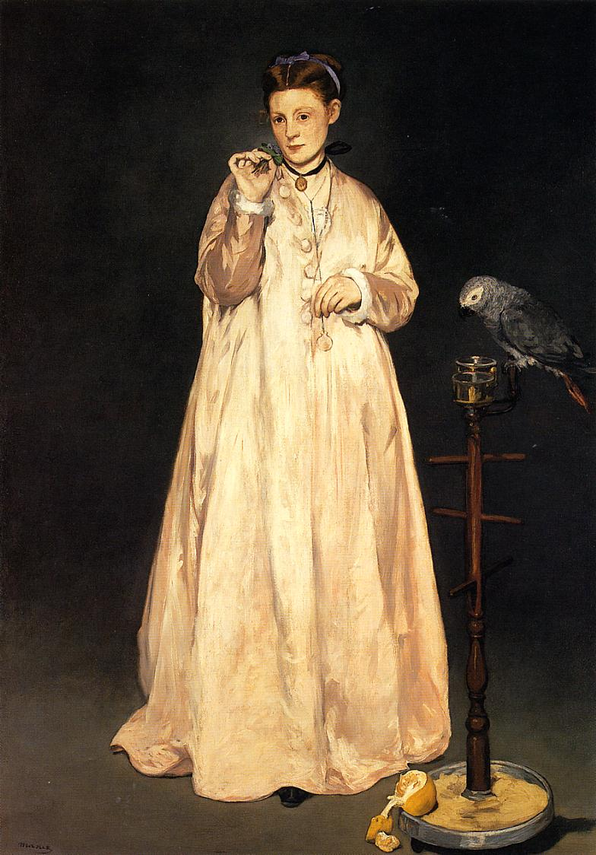
Manet
Woman with a Parrot
MMA

Slide 28
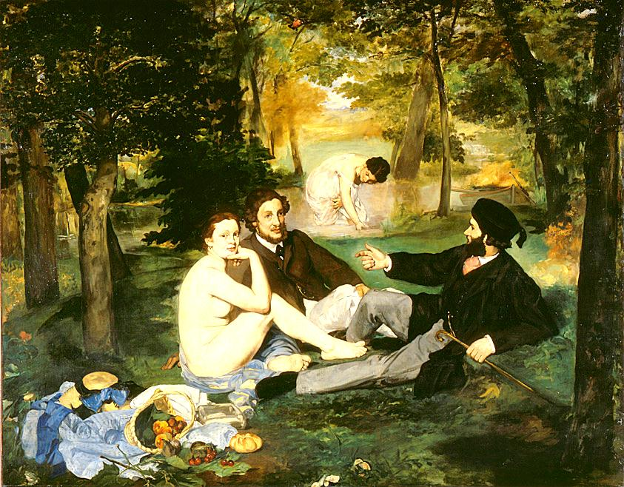
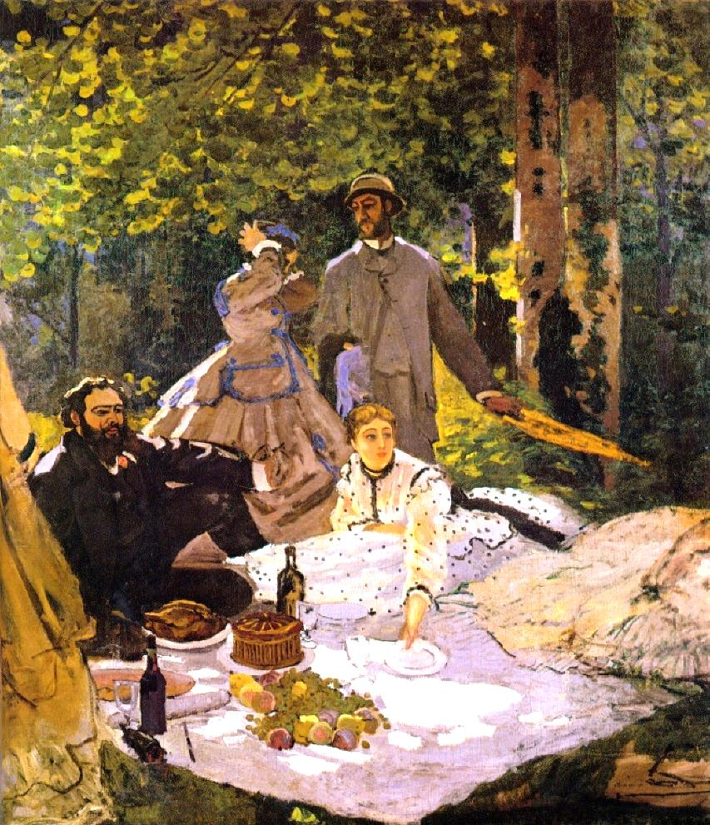
Luncheon on the Grass, Manet……………Monet
Courbet

Slide 29
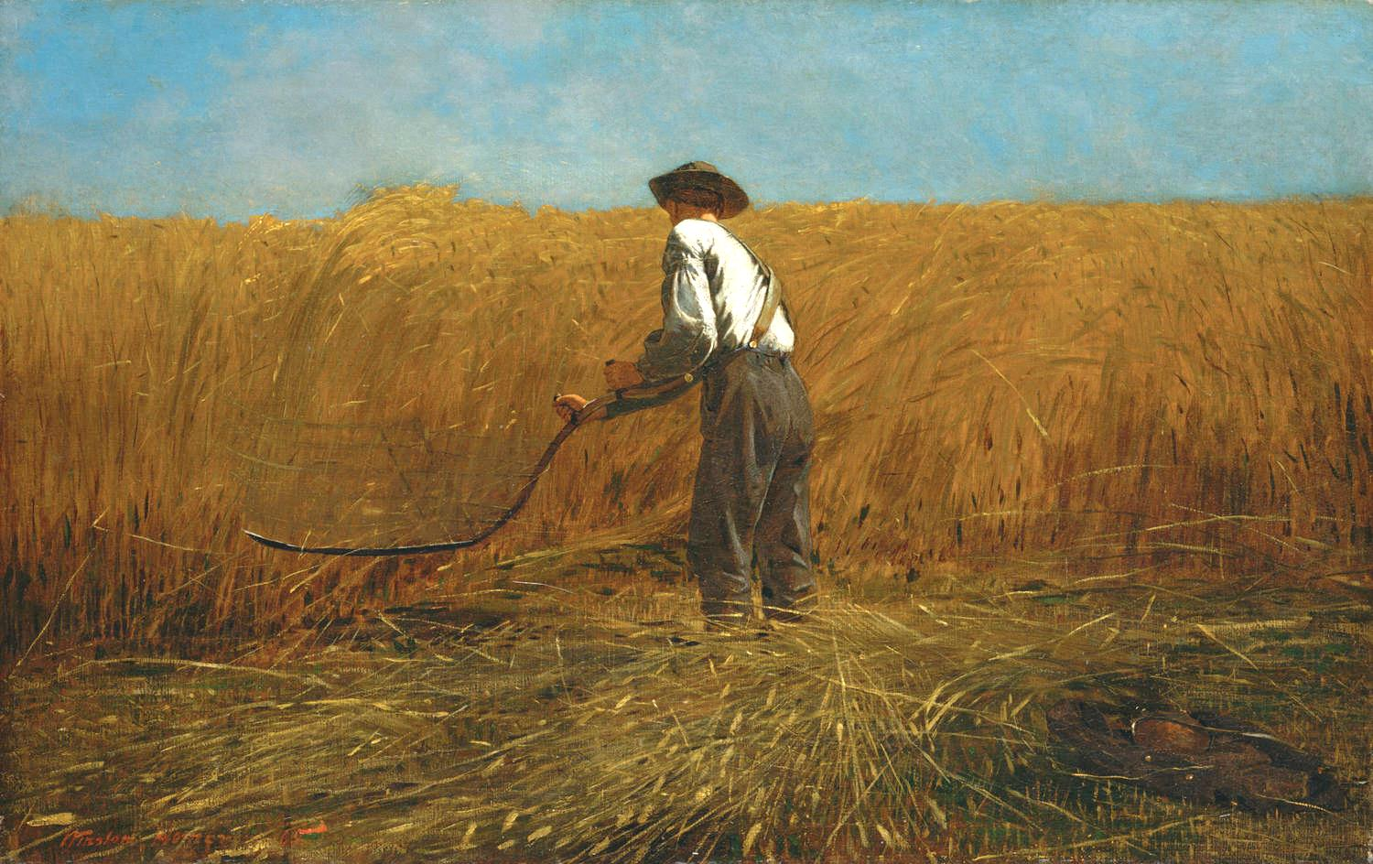
Winslow Homer (1836 – 1910). The Veteran in a new Field. 1865

Slide 30
Note the date-just at the end of the Civil War.
Also note Homer did not have the veteran use a modern cradled scythe,
But the single bladed scythe, the one the Grim Reaper uses!

Slide 31
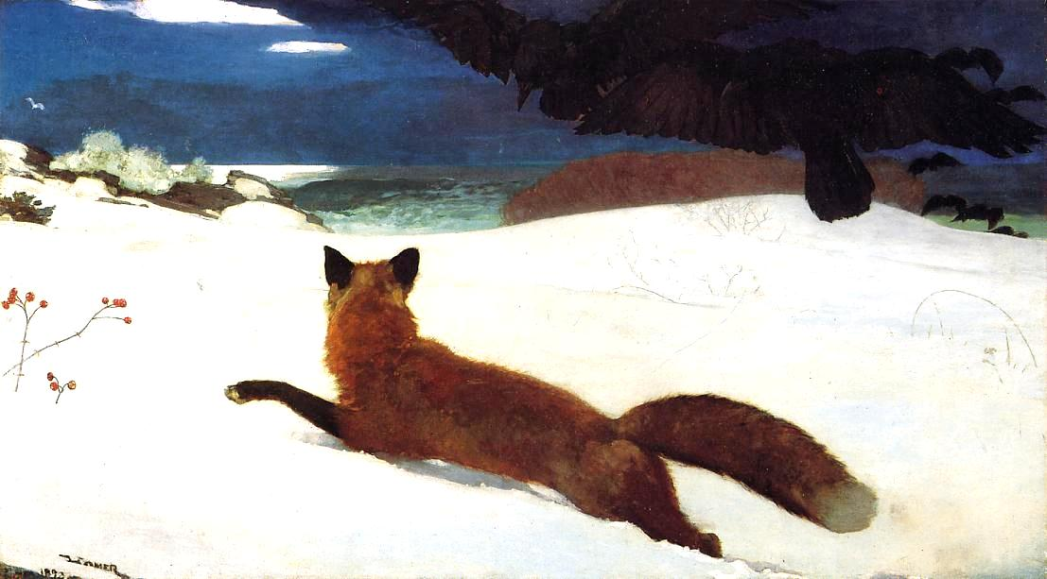
Winslow Homer, The Fox Hunt. 1893. Note the crow

Slide 32
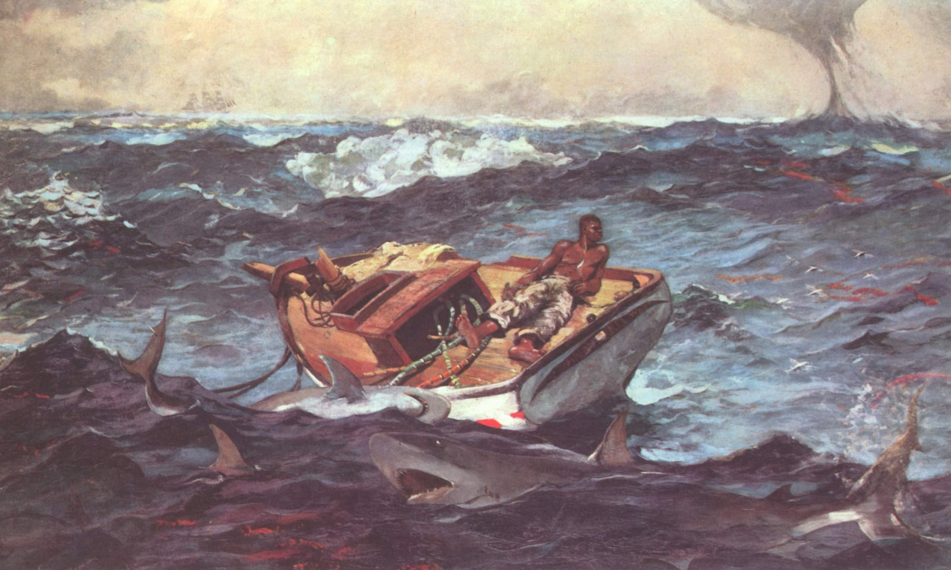
Homer, The Gulf Stream. 1899. MMA

Slide 33
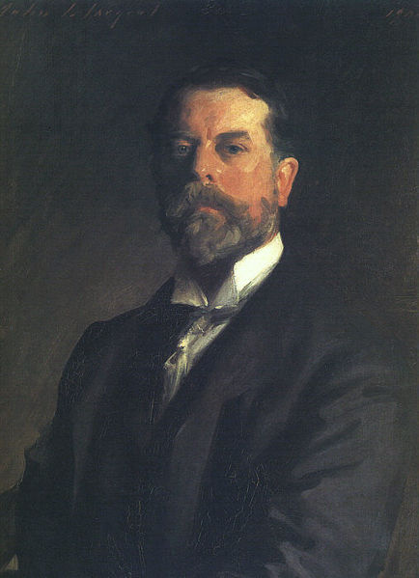
John Singer Sargent
1856- 1925) self portrait, his own realism

Slide 34
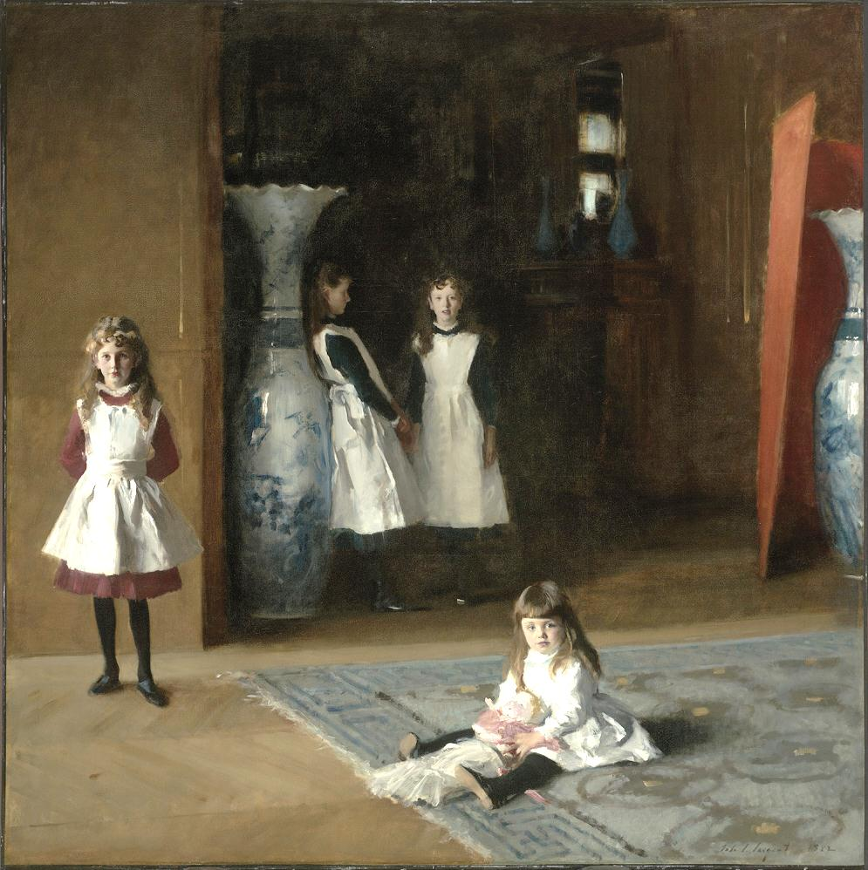
John S. Sargent,
The Daughters of
Edward Darley Boit,
1882. Painted in Paris
Note
Composition

Slide 35
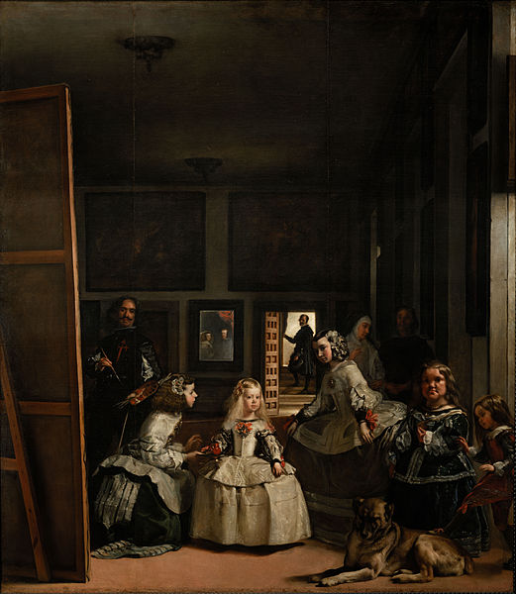
Sargent had copied
Valezquez’
Las Meninas
Show
"The Daughters of Edward
Darley Boit." by John
Singer Sargent
(Jesse Costa/WBUR)
Category

Slide 36
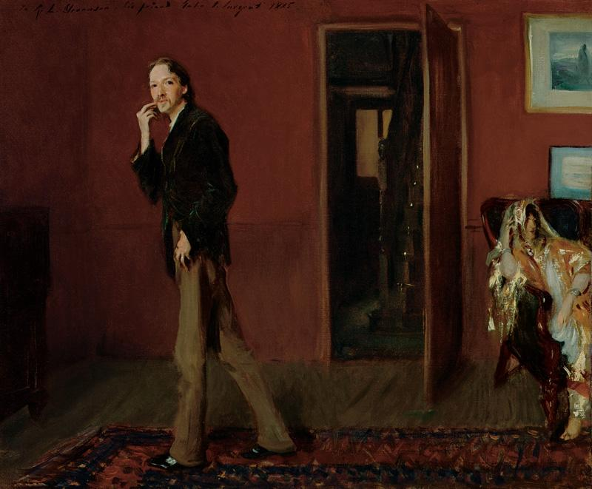

Slide 37
Robert Louis Stevenson and Wife

Slide 38
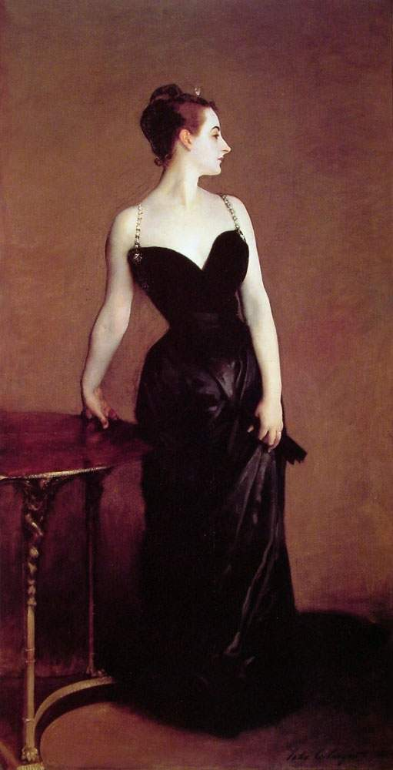
J S Sargant
Madam X. 1884. MMA
An American “looker” in Paris
Anonymity and strap over right
shoulder

Slide 39
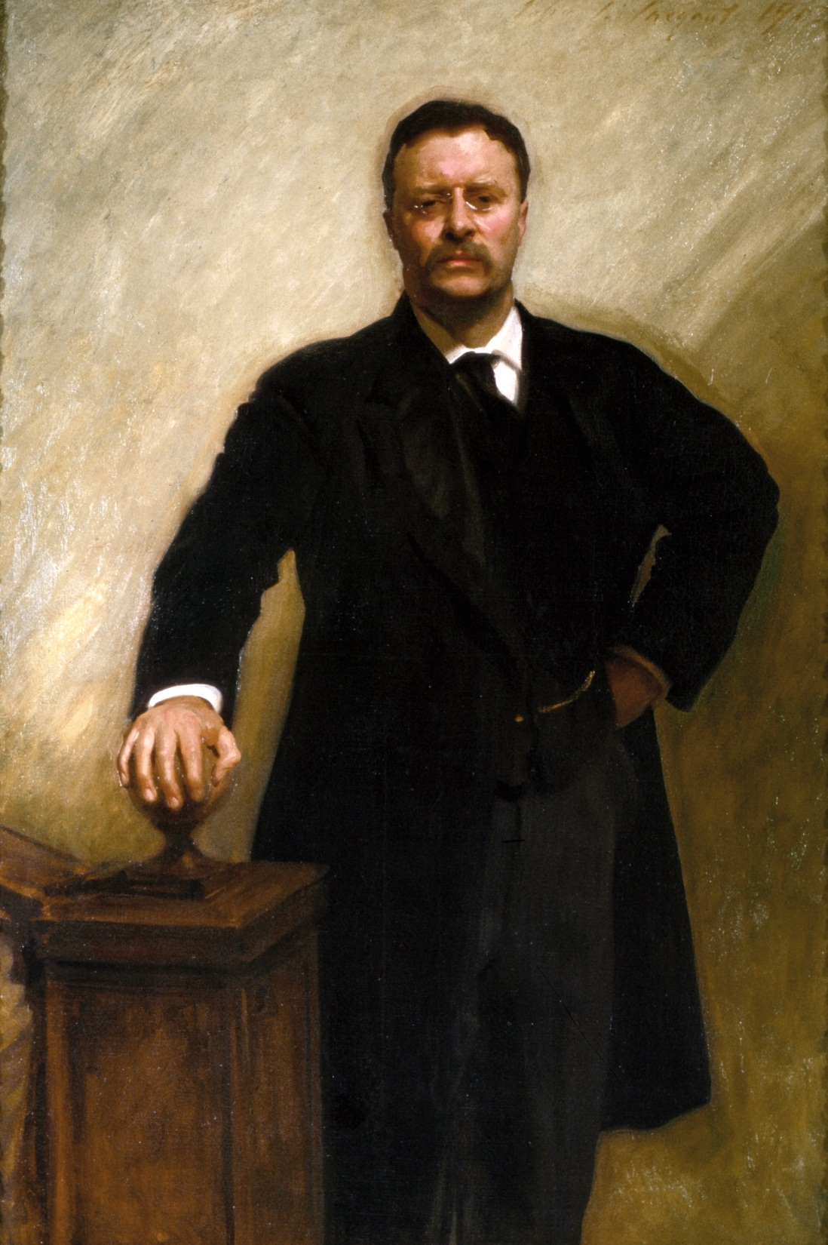

Slide 40
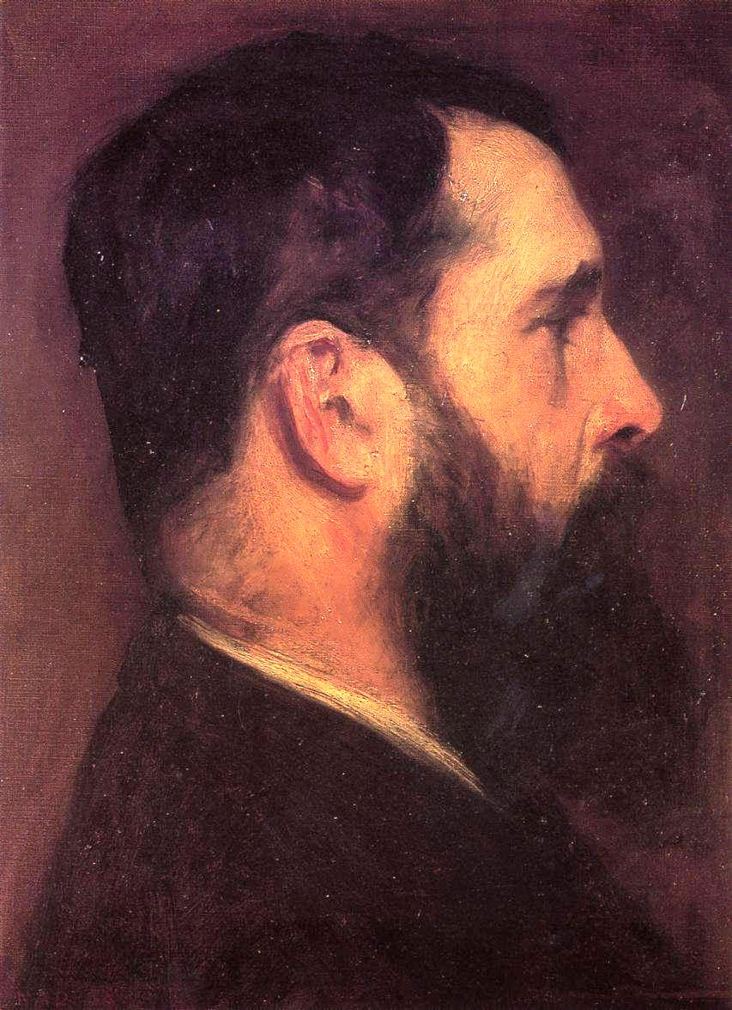
JS Sargent
Claude Monet

Slide 41
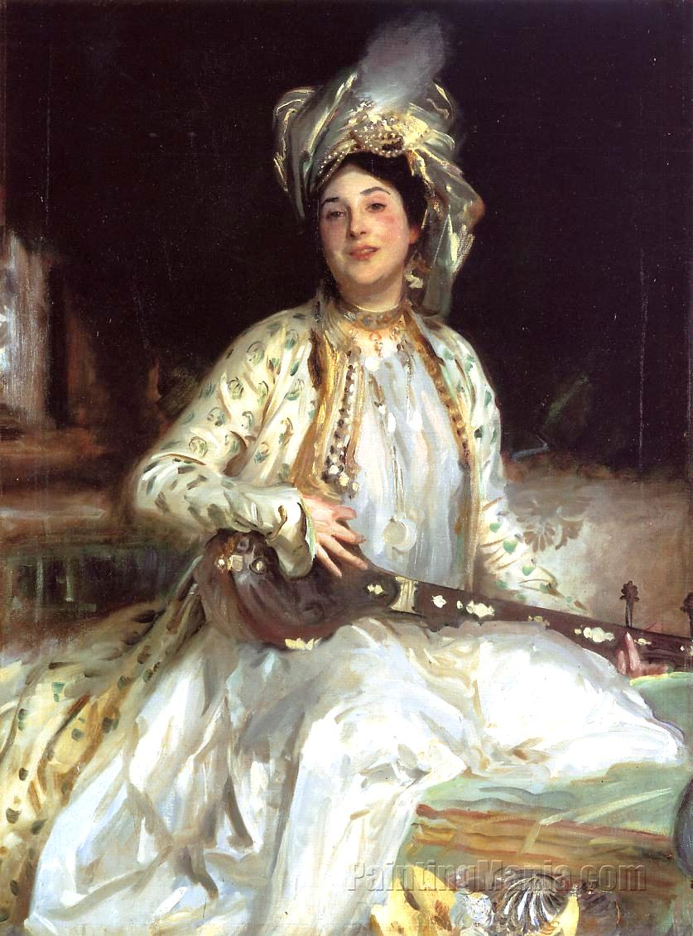
Let me be real clear,
JS Sargent was dismissed in Europe
as an anachronism.
This was because many of his patrons
were Jewish.
Almina, Daughter of Asher Wertheimer
Note the Dutch influence

Slide 42
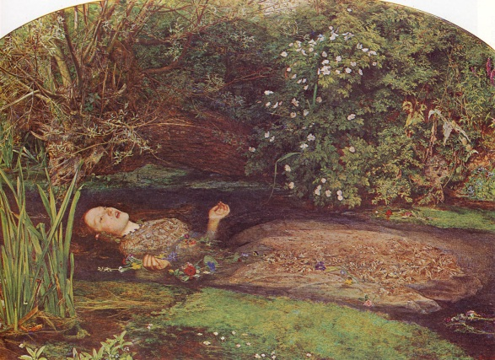
A different school-In praise of the Pre-Industrial Past:
The pre-Raphaelites
John Millais, Ophelia. 1852 (a Shakespearean heroine drowned. The model was
Dante G. Rossetti’s wife).

Slide 43
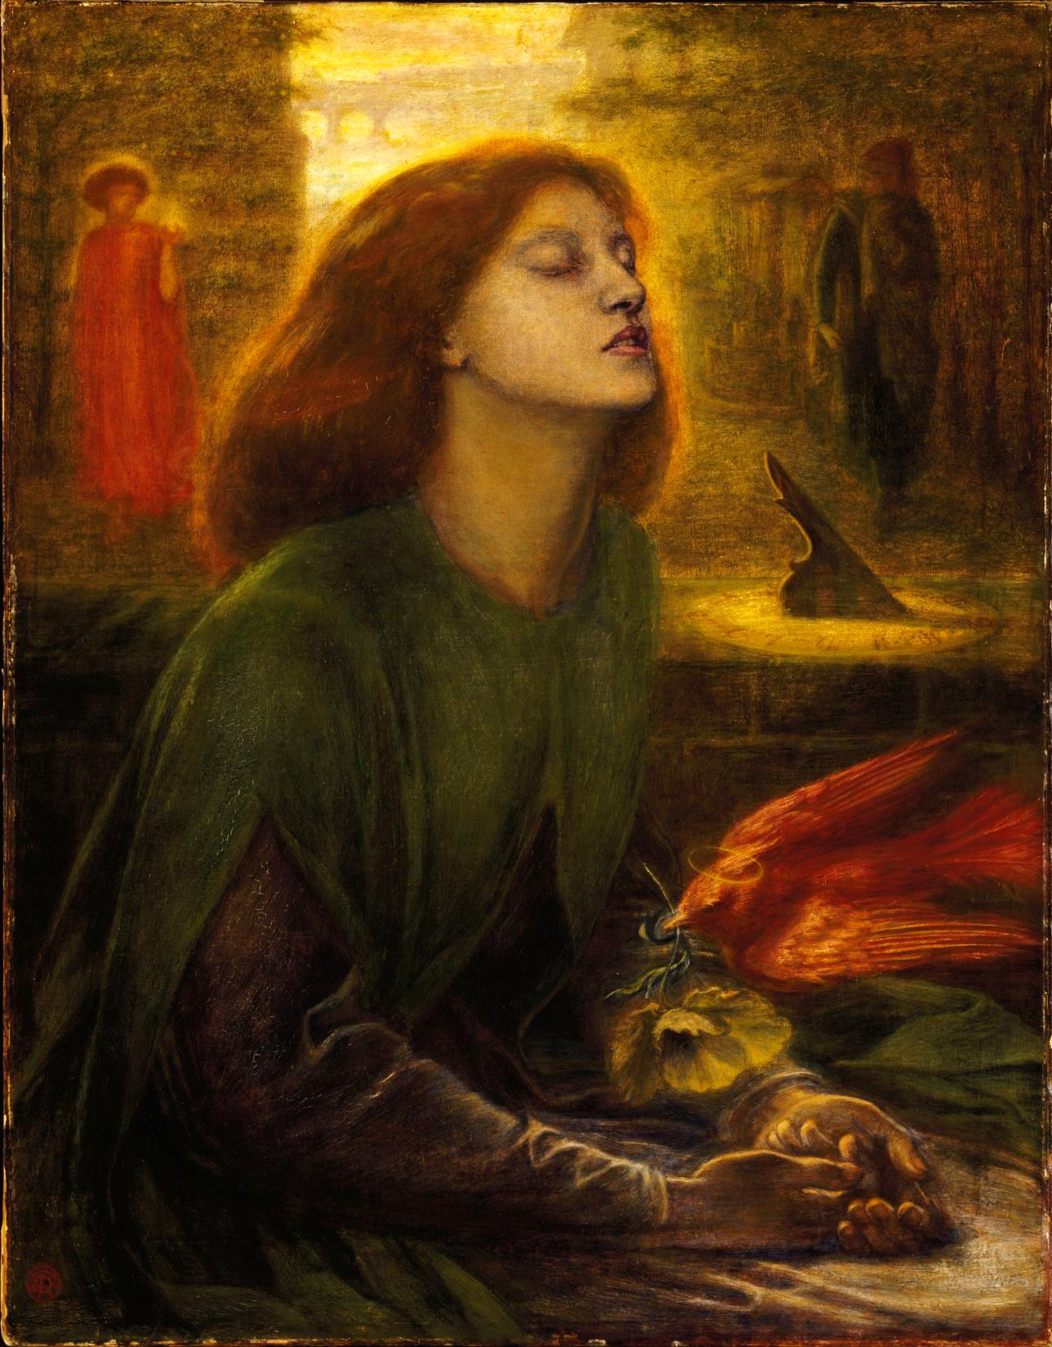

Slide 44
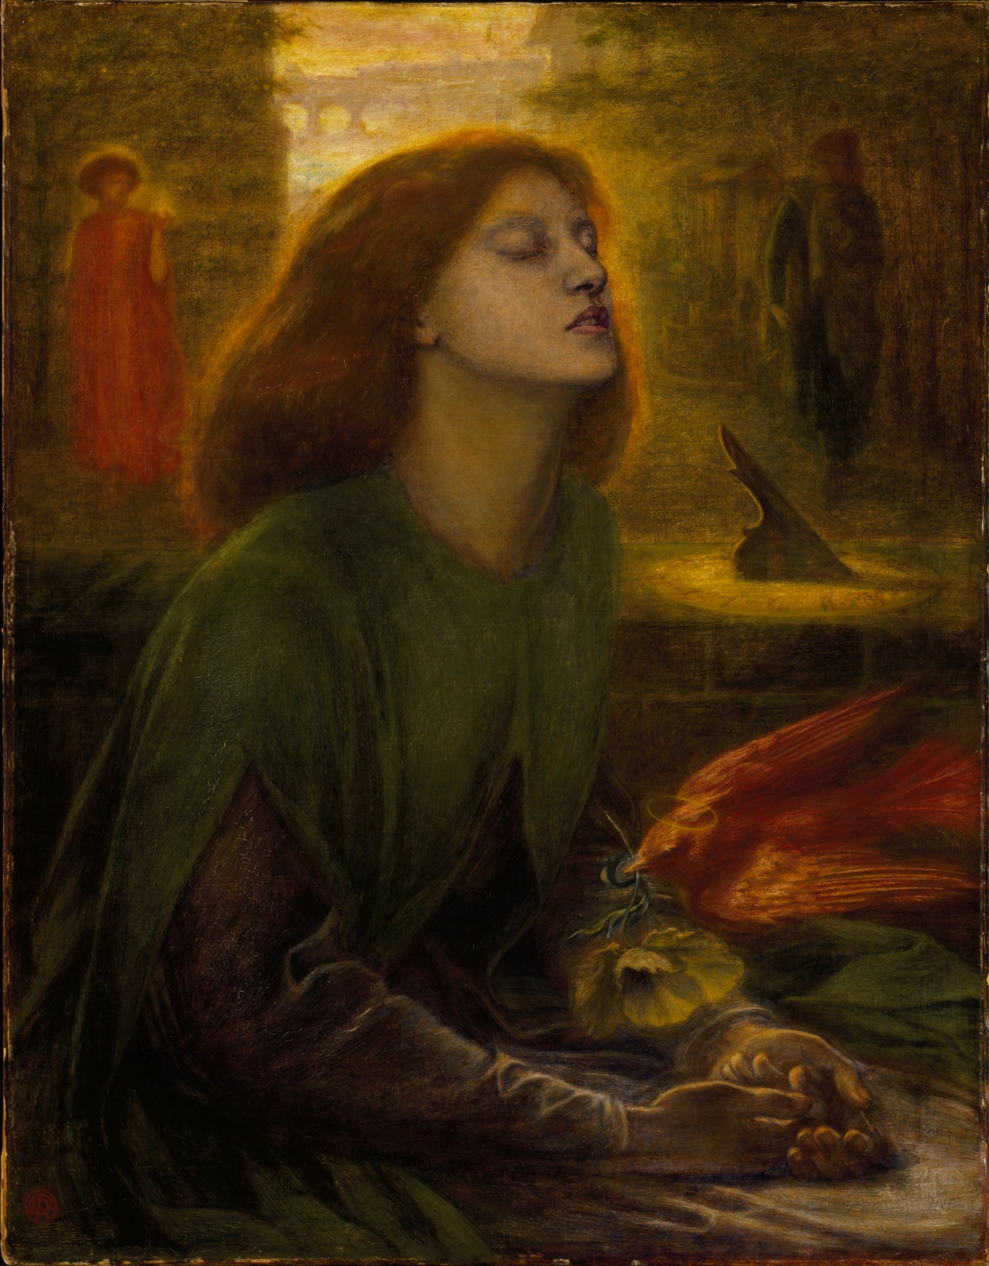
Dante Gabriel Rossetti,
Beata Beatrix. 1863.
From Dante’s (Medieval) novel
Rossetti’s wife had just died,
The dove is putting a poppy in
Elizabeth’s hands (she died of
An opium overdose, note the
Trance-like sleep.)

Slide 45
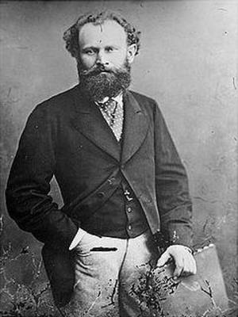
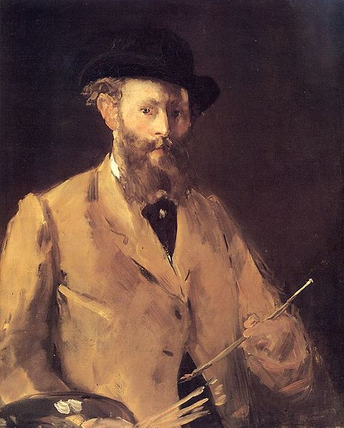
Eduard Manet
1832–1883
Self Portrait 1879

Slide 46
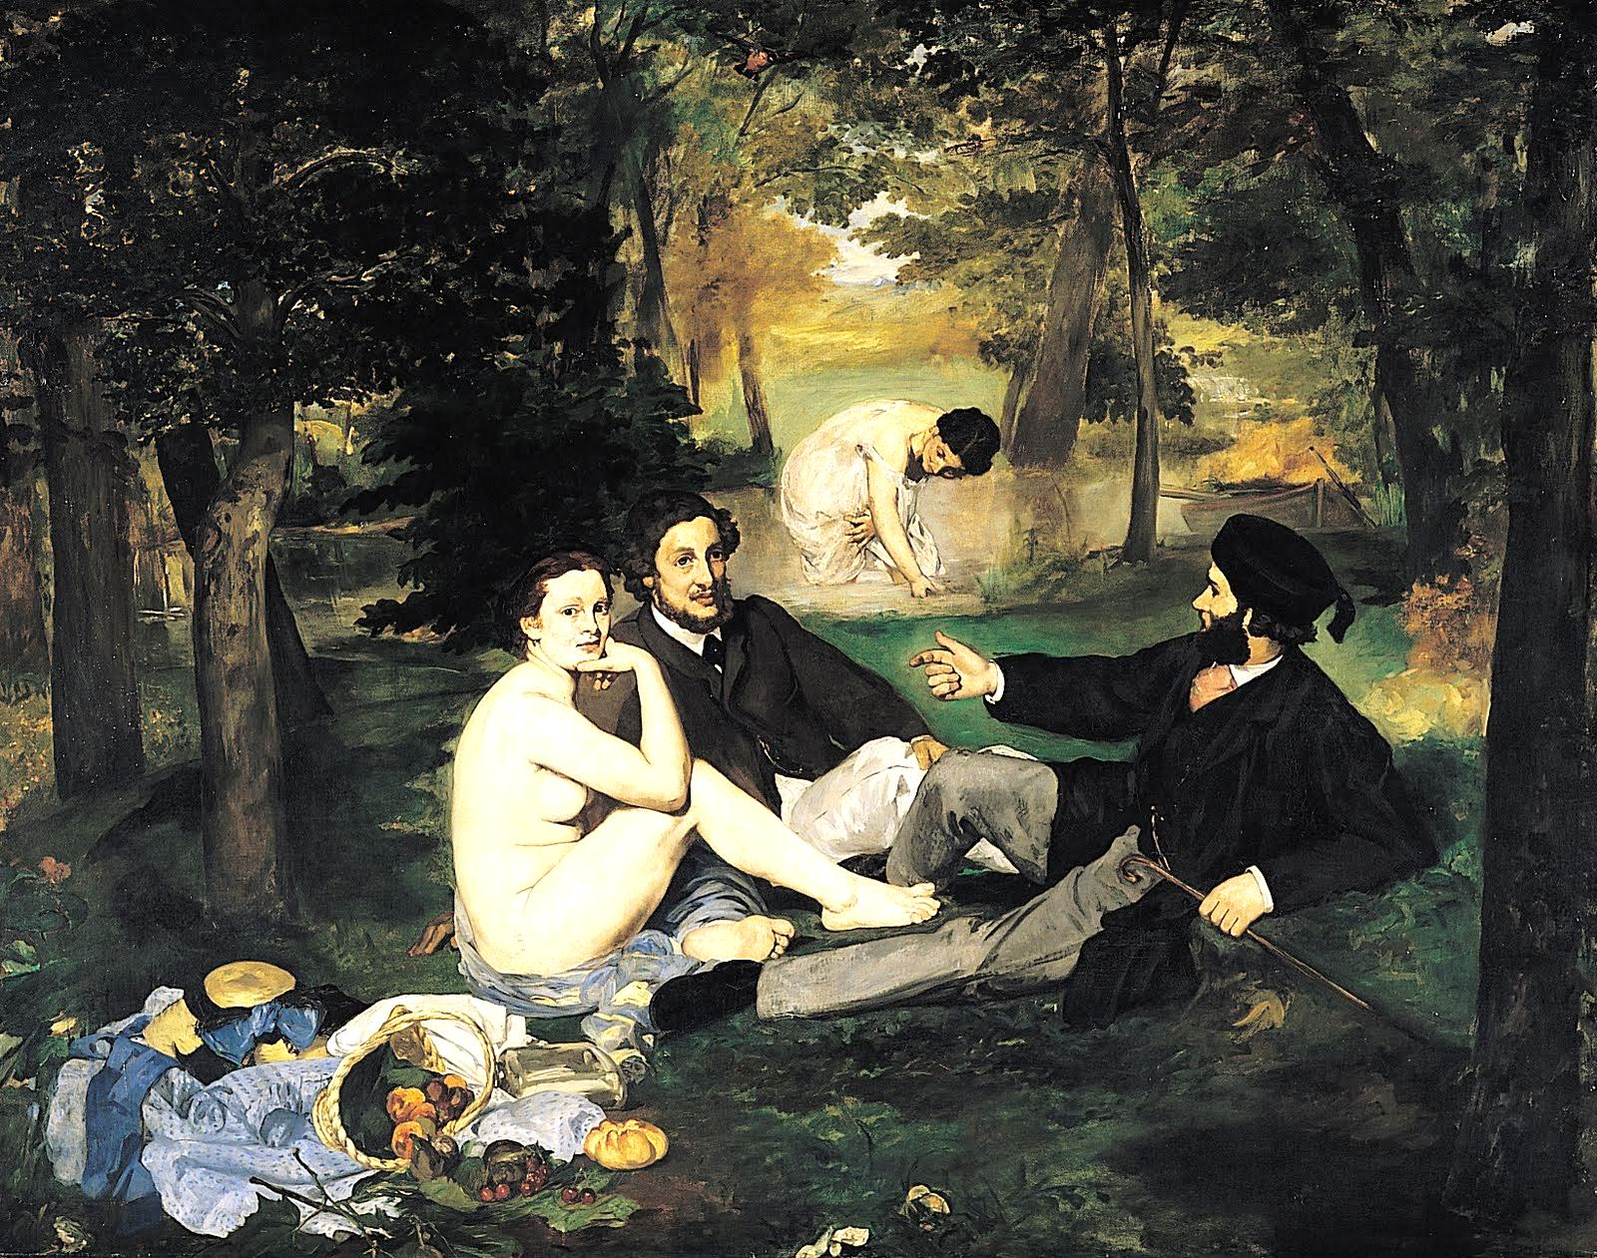

Slide 47
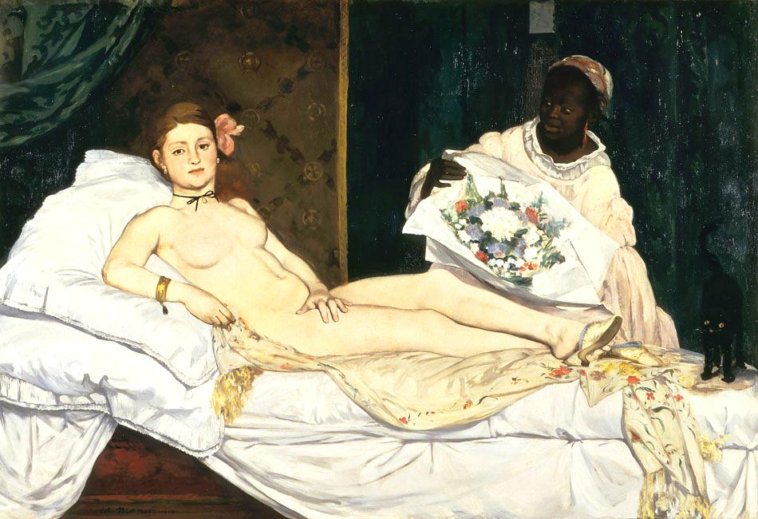

Slide 48
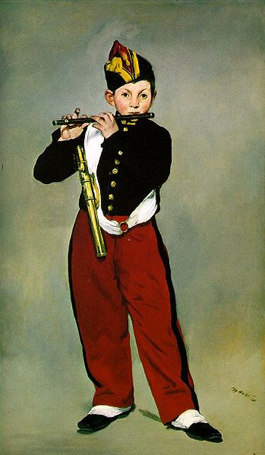
Young Flautist, or The Fifer,
1866 . D’Orsay

